Slide 1
First Day Information

Slide 2
Where am I?
PSYC 1103 – General Psychology I
TR 11:00am – 12:20pm

Slide 3
Who is this person? (2)
Dr. Maxwell
Cognitive Psychologist:
  Memory!
  Language!
  Attention!

Slide 4
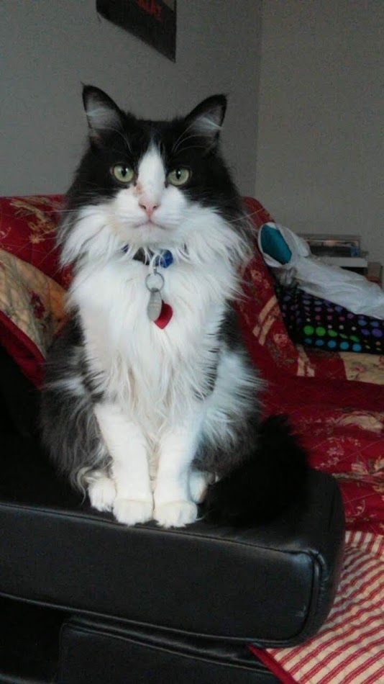
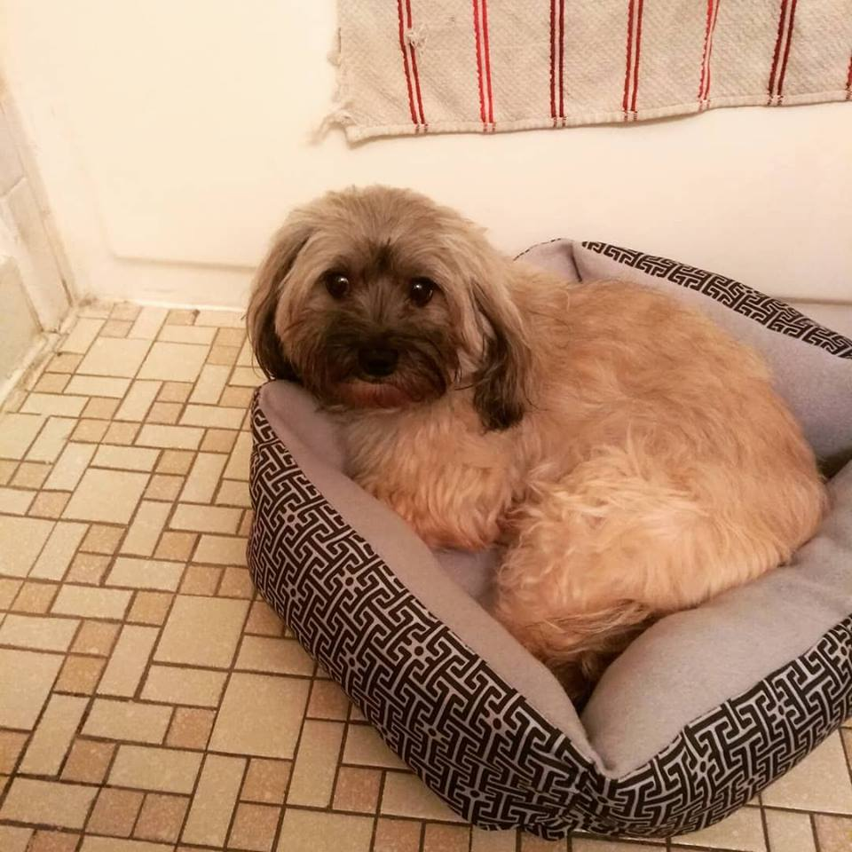



Who is this person? (3)

Slide 5
Your Turn!
Name:
Major:
Where you’re from:
What do you hope to gain from this class?

Slide 6
Finding Dr. Maxwell
Office hours: 2pm – 4pm MW; 2pm – 3pm F
Location: OD 118

Slide 7
Contacting Dr. Maxwell
How to contact me:
Email: nicholas.maxwell@msutexas.edu
  Please put course # and section # in header!
  24 – 48 hours (except on weekends)
Phone: ??? (don’t call me)
In person!

Slide 8
What do I get out of this Class?
A greater understanding of psychology as a scientific discipline
An overview of the history of psychology, different domains of research, and current trends
The relevance of psychology in today’s world

Slide 9

What will I Need?
Textbook: The Science of Psychology: An Appreciative View, 5th edition by Laura A. King (2020)
Something to take notes with

Slide 10

Desire2Learn (D2L)
Everything will be posted here. Lecture slides will be posted the day after each class.

Slide 11
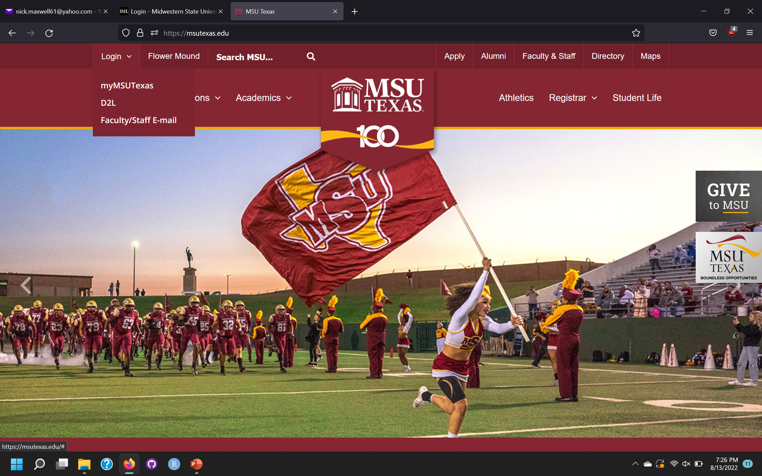
Accessing D2L

Slide 12
Quizzes
  11 Quizzes
    Worth 10 points each
    Lowest quiz grades get dropped at the end of the semester
    10 quizzes == 100 points total towards final grade
  Quizzes taken via D2L (due @ 11:59pm – see syllabus for specific dates!)

Slide 13
Exams
Five exams worth 100 points each (four during the semester + the final)
Lowest exam grade is dropped (400 points of final grade comes from exams)
First Exam: 9/13

Slide 14
Research Participation
  First-hand research experience is important!
    Students are required to participate in at least 90 minutes of research
    Or students can opt out and write a research ethics essay
    Last day to participate in Research: 11/18/22
  https://msutexas.edu/academics/libarts/psychology/

Slide 15
Computing your Grade
  600 total points
    Quizzes == 100
    Research == 100
    Exams == 400

Slide 16
Attendance Policy (1)
Attendance is required
  See syllabus for full attendance policy!

Slide 17
Attendance Policy (2)
Attendance Policy High-Points:
  Each student is allowed four absences (no questions asked)
  Fifth absence == 10% reduction of final grade
  Absences are unexcused unless:
    Emergency (written notification needed)
    Religious holiday (see University Attendance Policy)
    University Sponsored event

Slide 18
Attendance Policy (3)
What to do if you miss class?
    Check D2L for slides
    Email me within 24 hours if you miss an exam
    Documentation!

Slide 19
Important Dates
8/25 @ 11:59pm – Quiz 1
9/13 – Exam 1
10/6 – Exam 2
11/1 – Exam 3
12/1 – Exam 4
TBD – Final (Exam 5)
See the syllabus for full course schedule

Slide 20
Questions so far???

Slide 21
Doing Well in this Course!
Take good notes!
Think critically!
Use effective study strategies!

Slide 22
Critical Thinking in Psychology
Be a skeptic!
  Look for alternative explanations and contradictory evidence
  “It Depends” Behavior is rarely black or white (i.e., Men always act this way…)
Avoid all-or-none thinking
  Thinking in the extremes

Slide 23


Best Study Strategies
Practice testing
Distribute your restudy of the material
Take good notes
  Do not simply write and rewrite lecture slides/textbook materials, put the material in your own words and associate it to your own life (i.e., make the material meaningful to you)

Slide 24
Tips for Success
Note-taking
  You are not a courtroom recorder, write the information in your own words to make it meaningful!
Reading
  Apply the information to a real-world example in your life
Study for exams
  Do not simply “review” the information, be engaged!
The “Illusion of Mastery”
  Can you actually “recollect” the material?

Slide 25
Ask for help!
If something is unclear, ask me for help!
Please do not be afraid to send me an email
Please follow the syllabus carefully, the course moves quickly!

